Slide 1

Online Mobile Recharge System PROJECT – ANGULAR 10 & ASP.NET WEB API PAY

Slide 2



OUR TEAM
NAVEETH Z A RAJAGURUNATHAN M SARAVANAKUMAR B

Slide 3
AGENDA
Project Overview
About Rpay
Web API & Database Design
User Module

Slide 4
Project Overview
The proposed project for recharging mobiles
developed to automate the mobile
recharging process.
It roots out the manual card system of
recharge and introduces a new and genuine
online recharge process.
Tech stack:
Angular 10
Web API
Bootstrap 4
Material Designs

Slide 5
About Rpay
Online Mobile Recharge System is a Web
Based Application(RPAY) developed to recharge
Mobile Phones.
This System Focuses At Providing An Easy
And Reliable Platform To Recharge Mobile
Of Any Telecommunication Company Through
Online Without Buying Recharge Card

Slide 6
Web API & Database Design
ASP. Net WEB API
MS SQL SERVER 2019

Slide 7
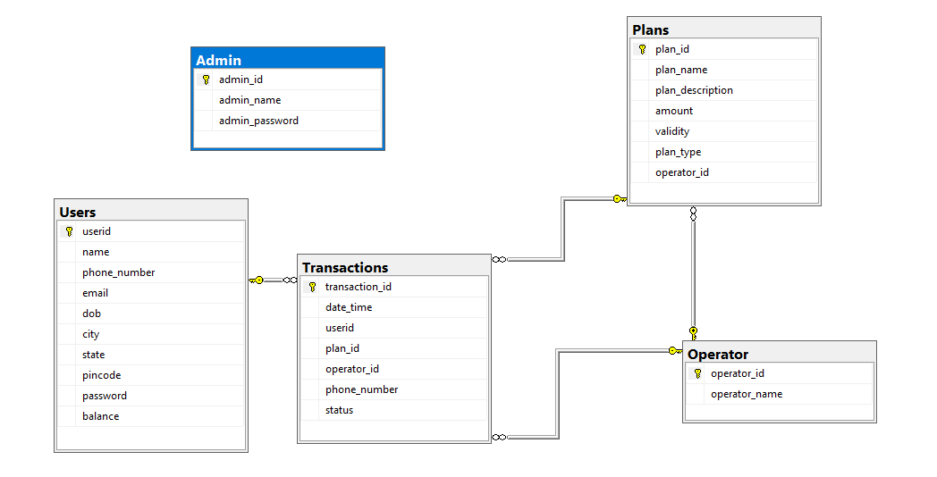
Database Design

Slide 8
WEB API Design
Web API Consists of Get Response method for all
Network Operators and will respond based on the
particular request.
GetAirtelPlans
GetAirtelPopularPlans
GetAirtelTalkTimePlans
GetAirtel4GDataVoucherPlans
GetAirtelInternationalRoamingPlans
the above mentioned are the get methods
for Airtel Operator.
Similarly same get methods with different operator names
are applicable for different network operator requests.

Slide 9
User Module
User Module consists of four mobile network operators.
Each mobile network operator have different plans with different plan categories.
User can able to view different network operator plans with some of the plan filters like
Popular Plans
Talk Time Plans
4G Data Voucher
International Roaming

Slide 10




USER MODULES (Our Mobile network partners)
A
B
J
VI

Slide 11
AIRTEL PLANS
Airtel Mobile Network operator provides various plans such as
Popular Plans - Combination of Internet , Talk Time , SMS.
Eg. Airtel 1.5 GB/DAY Packs
Talk Time - Audio call plans
Eg. Airtel 10 Talktime
4G Data Voucher - Internet plans
Eg. Airtel Add on 1
International Roaming - Roaming plans with Internet and Audio calls
Eg. Airtel Unlimited WiFi Calling

Slide 12
BSNL PLANS
BSNL Mobile Network operator provides various plans such as
Popular Plans - Combination of Internet , Talk Time , SMS.
Eg. BSNL 1.5 GB/DAY Packs
Talk Time - Audio call plans
Eg. BSNL 270 Talktime
4G Data Voucher - Internet plans
Eg. BSNL Work from Home packs 1
International Roaming - Roaming plans with Internet and Audio calls
Eg. BSNL InFlight Connectivity

Slide 13
JIO PLANS
Jio Mobile Network operator provides various plans such as
Popular Plans - Combination of Internet , Talk Time , SMS.
Eg. Jio 1.5 GB/DAY Packs
Talk Time - Audio call plans
Eg. Jio 500 Talktime
4G Data Voucher - Internet plans
Eg. Jio Work from Home packs 3
International Roaming - Roaming plans with Internet and Audio calls
Eg. Jio Value WiFi Calling

Slide 14
VODAFONEI PLANS
VodafoneI Mobile Network operator provides various plans such as
Popular Plans - Combination of Internet , Talk Time , SMS.
Eg. VodafoneI 2 GB/DAY Packs
Talk Time - Audio call plans
Eg. VodafoneI 70 Talktime
4G Data Voucher - Internet plans
Eg. VodafoneI Add on 2
International Roaming - Roaming plans with Internet and Audio calls
Eg. VodafoneI InFlight Connectivity

Slide 15
Thank you
BY RPAY TEAM
NAVEETH
RAJAGURUNATHAN
SARAVANAKUMAR

